Slide 1

E-Commerce Website for Automotive Parts
A full-stack e-commerce platform designed for seamless browsing, filtering, and purchasing of automotive parts and accessories. This comprehensive project includes a customer-facing storefront and a robust admin panel for efficient inventory and order management.
Internship Project by: Sahil Jadhav

Slide 2
Addressing Critical Challenges in Online Auto Parts Retail
The current landscape of online automotive parts purchasing is fraught with inefficiencies, creating significant pain points for both consumers and businesses. Our project directly addresses these critical issues:
Inaccurate Compatibility
Limited Product Details
Inefficient Order Management
Customers frequently struggle with the lack of precise compatibility checks, leading to incorrect part orders and frustrating return processes. Without detailed vehicle-specific filters, finding the right component becomes a daunting task.
Existing platforms often lack the detailed specifications and high-resolution imagery necessary for informed purchasing decisions. This deficiency can lead to buyer's remorse and increased customer support inquiries.
Sellers face substantial challenges with real-time inventory tracking and streamlined order processing. This often results in overselling, delayed shipments, and a poor overall customer experience due to manual and disconnected systems.

Slide 3

Strategic Objectives for a Superior Platform
Our project is meticulously designed to overcome the prevailing challenges in the automotive parts e-commerce sector, focusing on key functionalities that enhance user experience and operational efficiency.
1
Comprehensive Platform Development
Build a robust full-stack e-commerce platform specifically tailored for automotive parts and accessories, ensuring scalability and performance.
2
Advanced Search & Filtering
Implement intuitive browsing, filtering, and searching capabilities by make, model, year, and category to ensure accurate part compatibility for customers.
3
Secure & Seamless Transactions
Integrate a secure checkout process powered by Stripe payment gateway, offering a smooth and reliable purchasing experience.
4
Real-time Inventory & Order Management
Develop a comprehensive admin dashboard for real-time inventory tracking, efficient order processing, and detailed sales analytics.
5
Optimized User Experience
Ensure a responsive, accessible, and highly user-friendly interface across all devices (desktop, tablet, mobile), prioritizing ease of navigation and interaction.

Slide 4
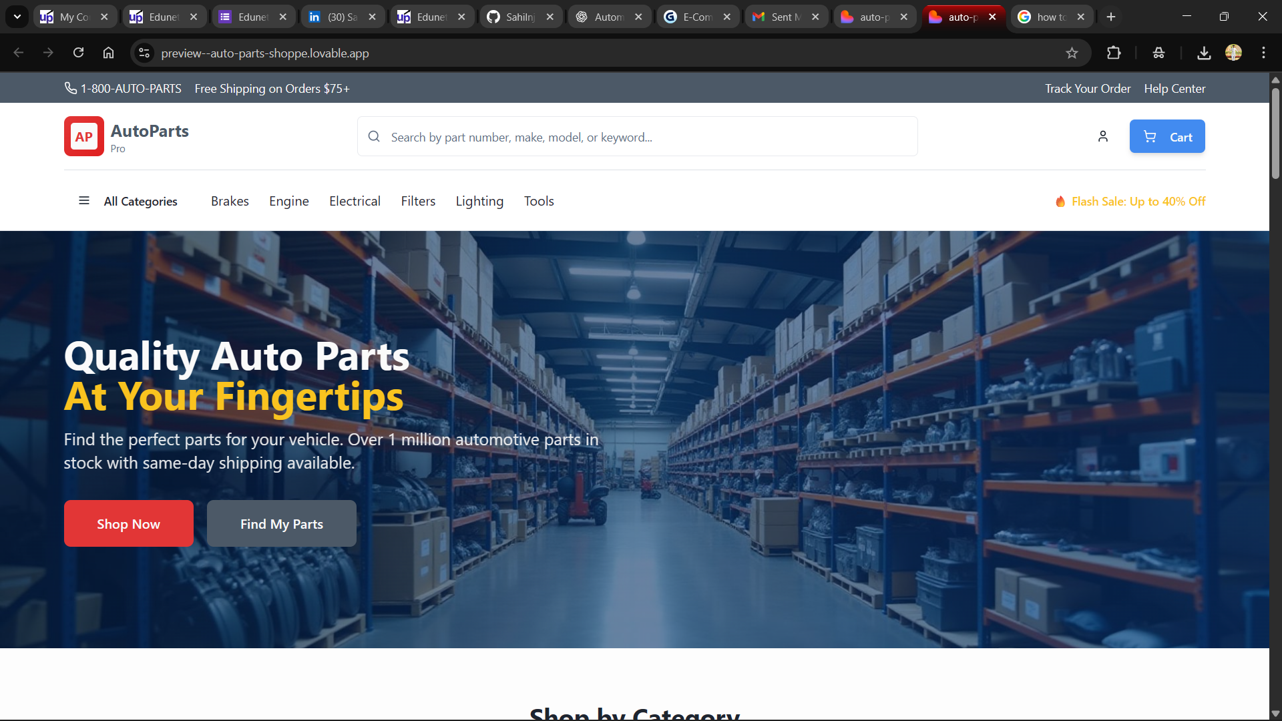

Slide 5
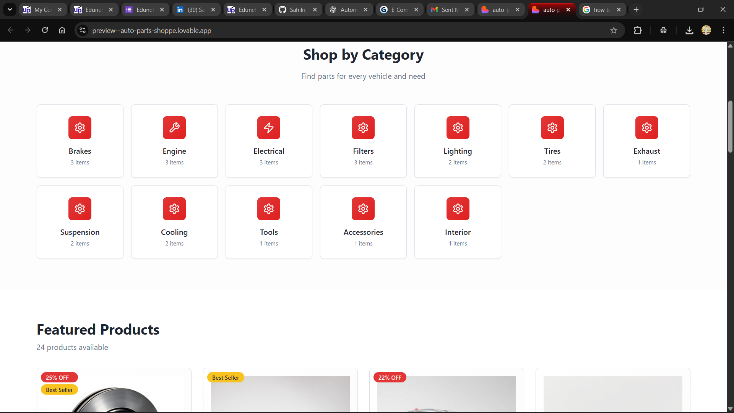

Slide 6
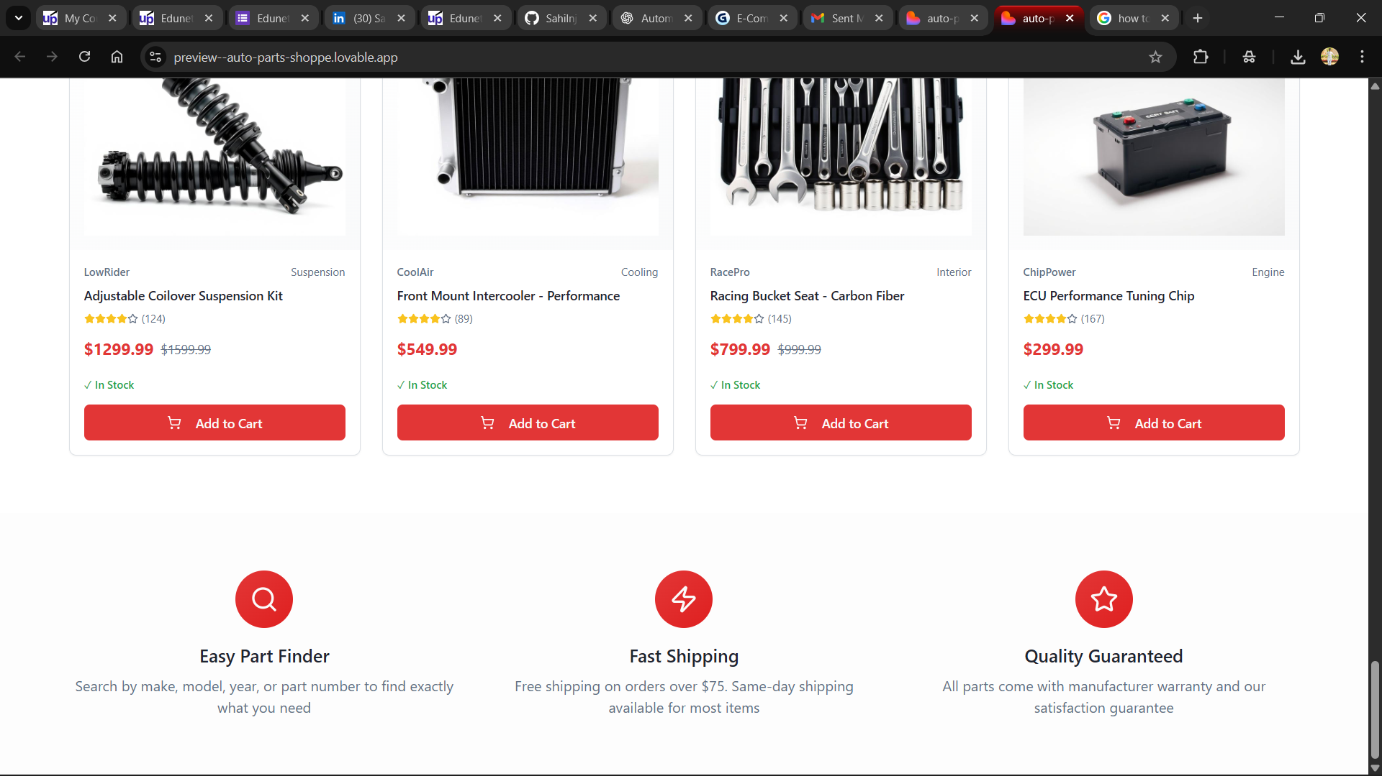

Slide 7
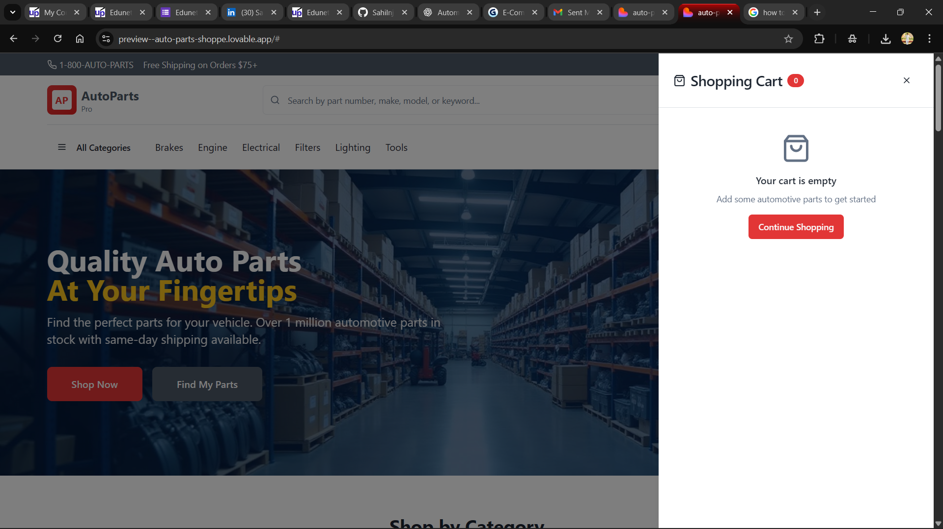

Slide 8
Agile Development Methodology
Our development process followed an agile approach, emphasizing iterative development and continuous feedback to ensure a high-quality, user-centric product. Each phase was executed with precision to build a robust and scalable platform.

Slide 9

Cutting-Edge Technology Stack
The platform is built using a modern and robust technology stack, chosen for its scalability, performance, and developer-friendly features, ensuring a seamless experience for both users and administrators.
Frontend Architecture
Backend & Database
React (Vite): For a fast and efficient development experience.
Node.js + Express: For building scalable server-side applications.
Redux Toolkit: For predictable state management.
MongoDB + Mongoose: For flexible NoSQL database management.
Tailwind CSS: For utility-first styling and rapid UI development.
JWT Authentication: For secure user authentication.
shadcn-ui: For beautifully designed, accessible UI components.
Key Features
Stripe API Integration: Enables secure and efficient payment processing.
Admin Panel: Provides comprehensive CRUD operations for products and orders, alongside essential sales analytics and inventory control.
Responsive Design: Optimized layout ensuring full functionality and aesthetic appeal across desktop, tablet, and mobile devices.

Slide 10


A Robust and Scalable E-Commerce Solution
This project stands as a testament to a successfully executed full-stack e-commerce solution tailored specifically for the automotive parts industry. It effectively addresses critical market demands while demonstrating strong technical proficiency.
Challenges Overcome
Scalability & Performance
Successfully navigated complexities related to accurate product compatibility, real-time inventory management, and secure transaction processing.
Engineered with a modern tech stack ensuring the platform can handle increasing user loads and data volumes effectively.
User-Centric Design
Real-World Readiness
Delivers an intuitive and accessible experience, prioritizing ease of use and a smooth purchasing journey for customers.
The system is primed for deployment, meeting both rigorous academic benchmarks and practical industry standards for usability and functionality.
This project not only fulfills its academic objectives but also provides a tangible, high-quality solution ready for real-world application in the dynamic e-commerce landscape for automotive components.

